Slide 1

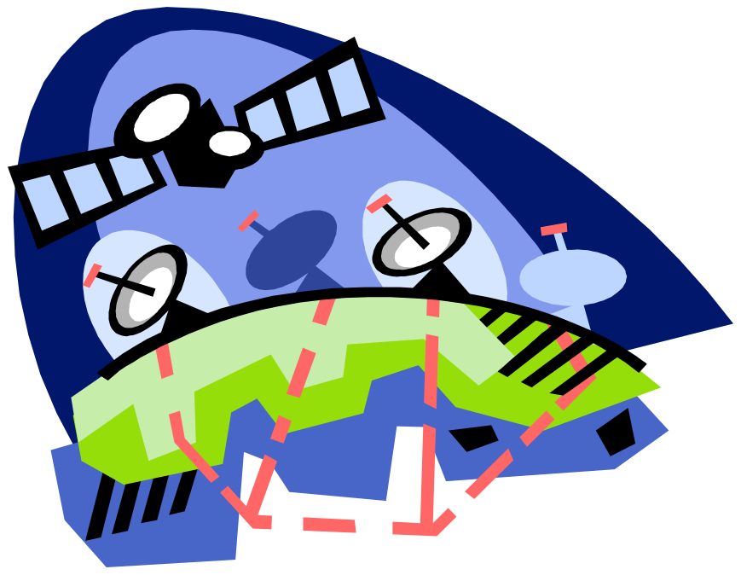
Delay/Disruption Tolerant Networking
Carlo Caini
carlo.caini@unibo.it
DEI/ARCES University of Bologna, Italy

Slide 2
Introduction
Some assumptions at the basis of TCP/IP
  End-to-end connectivity
    Communication is possible if exists at least a continuous path between source and destination
  Short RTT
    Loss recovery based on ARQ efficient
  Few Losses
    Most due to congestion
“Challenged networks”
  Environments where one or more of the previous assumptions do not hold
DTN (Delay/Disruption Tolerant Networking)
  A novel networking architecture to cope with challenged networks
  DTN-DINET w/ Vint Cerf You Tube (3 min)

Slide 3
Background
1973 –Cerf’s and Kahn’s work on TCP
Early ‘90 –Researchers at NASA Jet Propulsion Laboratory (JPL) try to adapt Internet protocols to space missions
1998 –Cerf at alii promoted the Interplanetary Internet (IPN)
May 2001 –“Interplanetary Internet: Architectural Definition” Internet draft 00
  Necessity of a new architecture
  Whereas the Earth’s Internet was basically conceived as a “network of connected networks,” the IPN was thought of as a “network of disconnected Internets” connected through a system of gateways forming a stable backbone across interplanetary space.
August 2002-updated version of the draft as “Delay-Tolerant Network Architecture: The Evolving Interplanetary Internet” internet draft 01
  The new architecture can be applied to other environments (“challenged networks”)
October 2002
  IRTF DTNRG start
    “It is an open research group, meaning that anyone interested can contribute simply by joining the mailing list and getting involved in the work”.
<number>/

Slide 4
IRTF-DTNRG & IETF-DTN
Members of DTNRG first, and now of IETF DTNWG, are concerned with how to address the architectural and protocol design principles arising from the need to provide interoperable communications in performance-challenged environments.
Examples of such environments include
  Spacecraft
  military/tactical
  some forms of disaster response
  Underwater
  and some forms of ad-hoc sensor/actuator networks
  Internet connectivity in places where performance may suffer such as developing parts of the world.
Site of DTNRG (now closed): https://sites.google.com/site/dtnresgroup/home
2015-from IRTF to IETF (from Research to Engineering)
  IETF DTN WG start: https://datatracker.ietf.org/wg/dtn/charter/

Slide 5


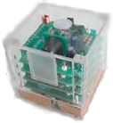

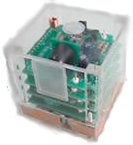

The DTN architecture
Segment C
Segment A
Segment B

Slide 6
The DTN architecture
It is based on the introduction of the Bundle layer between Application and Transport
  “Bundles” are (large) data packet at this layer
  Store and forward architecture
    A bundle is first received, stored, and then transmitted (when possible)

Slide 7
Bundle Layer
Bundle Layer
Application
Application
Transport
Transport
Transport
Network
Network
Network
Datalink
Datalink
Datalink
Physical
Physical
Physical

Slide 8
Bundle Layer
Regione A
Regione B
Application
Application
Bundle Layer
Transport A
Transport A
Transport B
Transport B
Network A
Network A
Network B
Network B
Datalink A
Datalink A
Datalink B
Datalink B
Physical A
Physical A
Physical B
Physical B

Slide 9
First basic concept: overlay network
End-to-end path in a heterogeneous network divided into multiple DTN hops
Transport end-to-end semantics confined inside each DTN hop
Possibility to use different protocol stacks in different DTN hops
  TCP or transport protocols optimized to channel characteristics of each DTN hop
Note DTN is not truly end-to-end, but just hop-by-hop

Slide 10
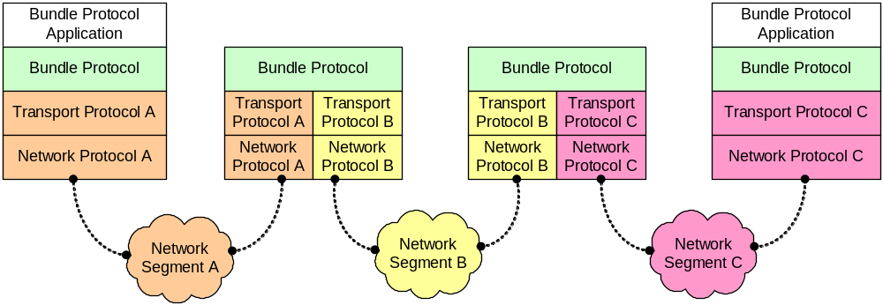
DTN overlay over a heterogeneous network

Slide 11
Second basic concept: information stored inside the network
Why necessary
  To cope with the possible lack of a continous end-to-end path (e.g. “data mule” applications)
  More efficient loss recovery with long RTT
Custody transfer option
  The task of successful bundle delivery to destination is moved forward to the next DTN custodian
  Bundles are deleted only when a following custodian has accepted the custody (or the bundle expires)
  Bundles are retransmitted after a given interval, unless a custody acceptance signal has been received.

Slide 12
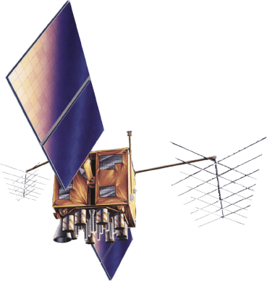

Bundle Transfer
Bundle Layer

Slide 13
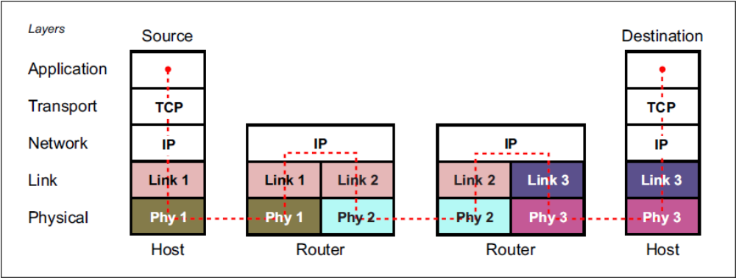
The TCP/IP architecture

Slide 14
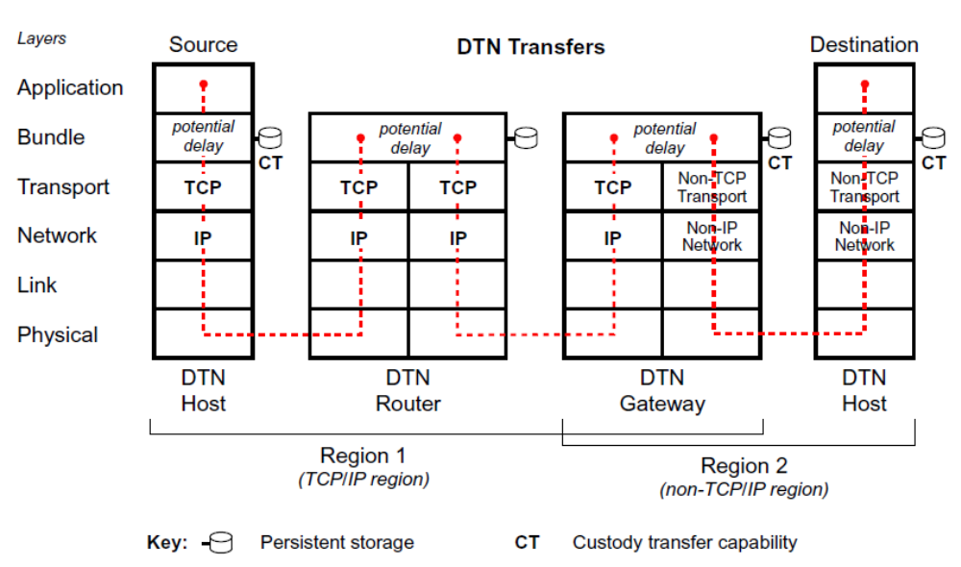
The DTN architecture
Note: between two DTN nodes, we can have many intermediate Layer 3 routers (not reported in the figure)

Slide 15
DTN evolution
2007
  RFC 4838: V. Cerf et al., Delay-Tolerant Networking Architecture, IETF RFC 4838, Apr. 2007
  RFC5050: K. Scott and S. Burleigh, Bundle Protocol Specification, IETF RFC 5050, Nov. 2007
2008
  The Saratoga project at the University of Surrey: first to test the bundle protocol in space (LEO satellite)
  First NASA experiments
2011
  Many RFCs on DTN security, routing, and various other BP extensions.
  CGR routing introduced
2012
  DTN2 Bundle Layer Reference Implementation 2.9 released (Sourceforge) (and no more updated…)
2015
  Start of IETF (“Engineering”) standardization
  CCSDS tests on BP interoperability (DTN2&ION) successful
  IBR-DTN 1.01 released (GitHub) https://www.ibr.cs.tu-bs.de/projects/ibr-dtn/
2018
  ION 3.6.2, DTN protocol Implementation released by NASA (Sourceforge);

Slide 16
Research prospects
Scientific challenge
  To integrate DTN features in Future Internet
    Open issues: routing, security, congestion control.
Future prospects
  Interplanetary Internet and Space Communications (yes, for sure)
  Smartphones?
  Aeronautical communications?
  Internet of Things?
  Others?

Slide 17
Unibo research activity
Research topics
  DTN protocols
    LTP+ECLSA & HSLTP (LTP+Packet Layer coding)
  DTN Routing
    CGR/SABR
    Source routing
    Routing based on metadata
  DTN applications (DTNsuite)
    Abstraction Layer
    DTNperf
    DTNproxy
    DTNbox
    DTNfog
Development of evaluation tools and testbeds
  CGR&OCGR in the ONE simulator
  Virtualbricks (our virtual testbed manager)

Slide 18




DTNperf_3: client, server & monitor
Bundle
Bundle
ACK
ACK
Client
Server
Status
Report
Status
Report
Status
Report
Monitor
.csv
file

Slide 19
DTNperf_3 & CGR research: images from the far side of the Moon…
Dotted lines=space intermittent links (windows of visibility)
Continous lines=terrestrial continous links
Two routes possible (via GW or direct); the choice is dynamic (as for trains or flights)
Lunar Satellite (Sat)
Lander
Route via GW
Direct route
Non- institutional user
Internet
Gateway (GW)
Mission Control Centre (MCC)

Slide 20
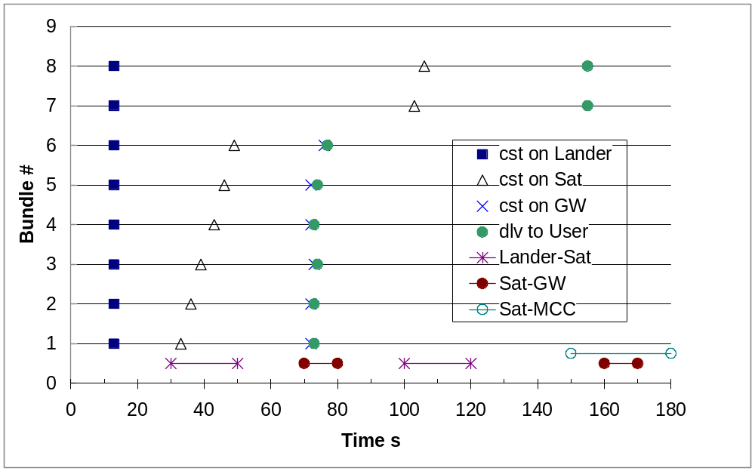
DTNperf & CGR:images from the far side of the Moon…
The 8 bundles generated on Lander have to be delivered to User
  First 6 transferred to Sat during the 1st Lander-Sat window; then routed via GW;
  Last 2 transferred during the 2nd Lander-Sat window, then routed directly to MCC

Slide 21
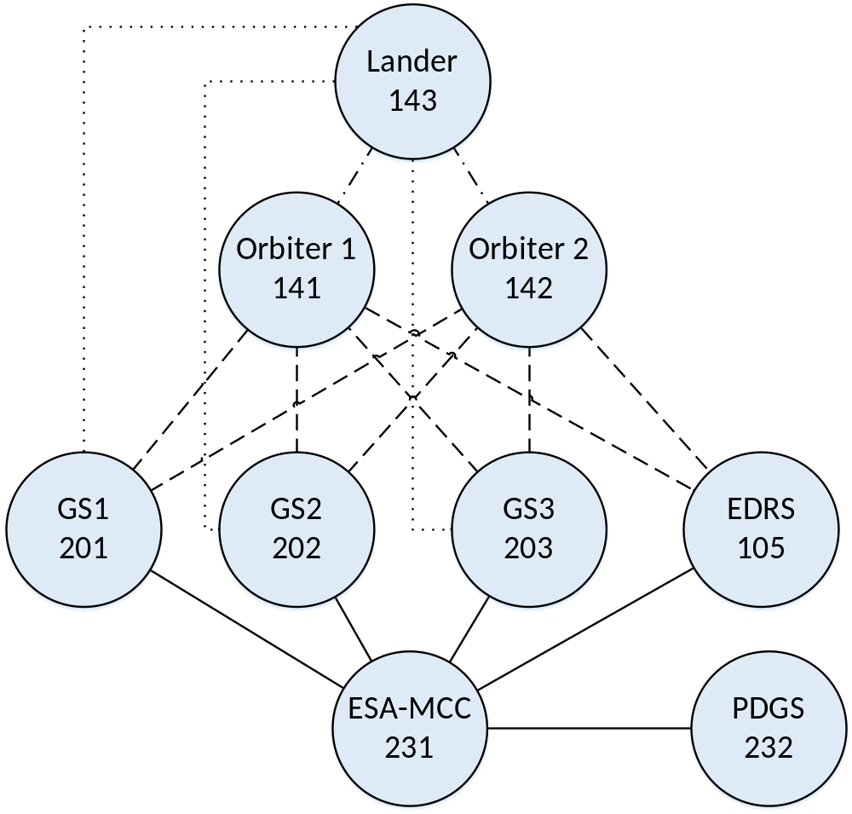
Mars-Earth scenario: logical topology
9 DTN nodes:
Lander on Mars
2 Martian Orbiters
3 Ground Stations
1 GEO sat system (EDRS)
2 destination nodes on Earth

Slide 22
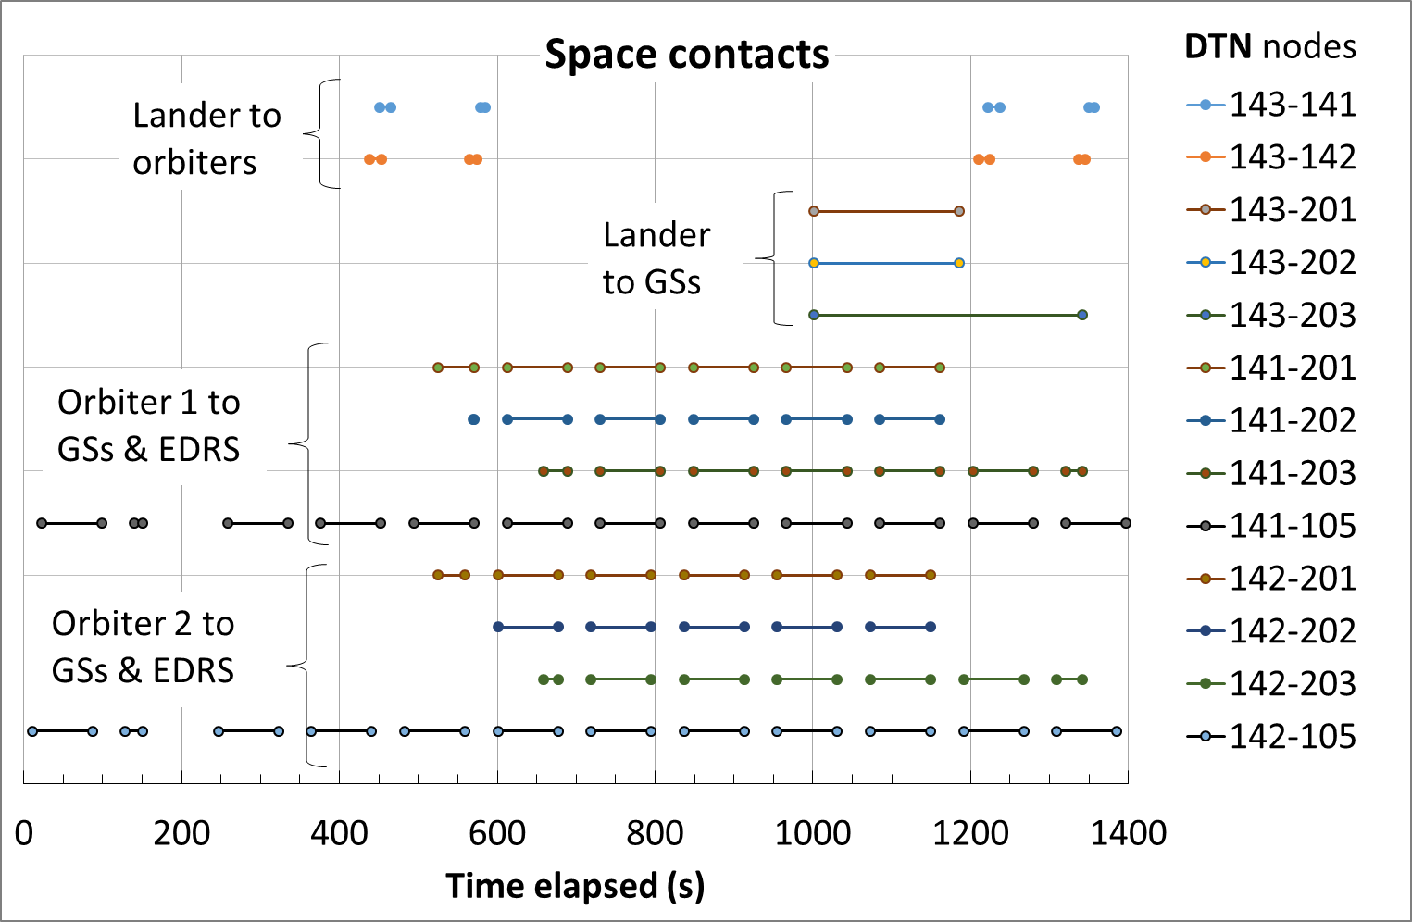
Mars-Earth scenario: Contacts

Slide 23
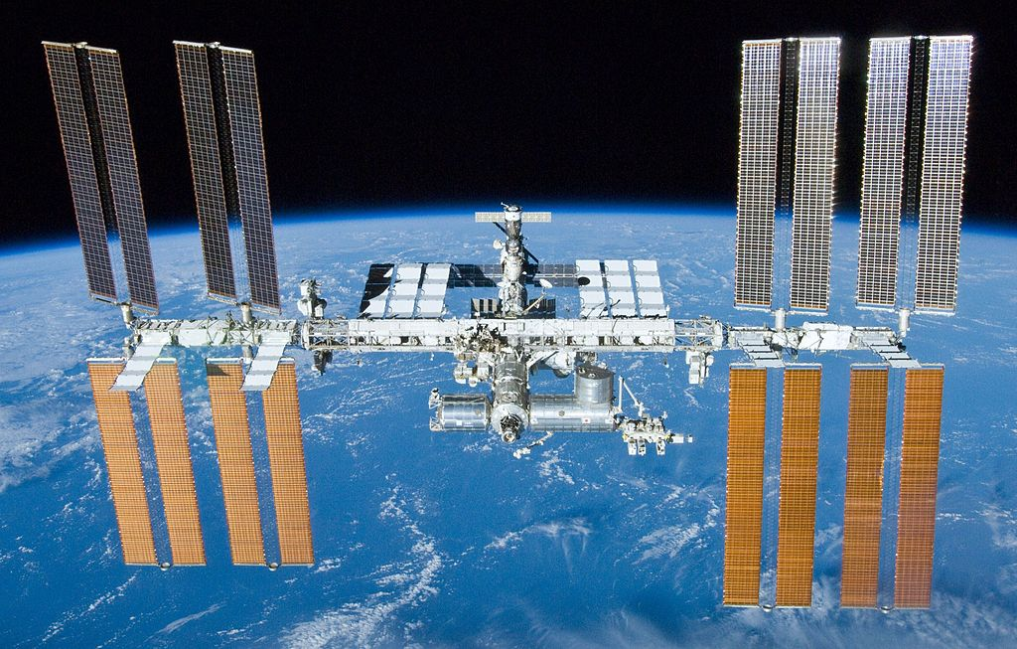
1998-present: cooperation in space, the International Space Station
  The ISS is the result of a wide international cooperation, NASA, Roscosmos, JAXA, ESA, CSA
  After the American Space Shuttle program ended in 2011, Russian Soyuz rockets are the only means of transport to ISS for all astronauts.
  DTN nodes are on board!

Slide 24
Link su ISS e dintorni
Vita a bordo ISS
ISS astronauti italiani
SpaceX_Dragon_27_maggio_2020
il-giorno-di-crew-dragon-lancio-storico
Artemis (Moon)

